Slide 1
Combined Stakeholder Group
Q2 2018 Meeting
June 15, 2018 (9AM – 1:30PM)

Slide 2
AGENDA
Combined Stakeholder Group
9:00 – 9:05 | Welcome & Introductions | Kevin Cray
9:05 – 9:15 | Admin. & Action Items from Last Meeting | Neil Cowan
9:15 – 9:30 | Renewable*Connect & Renewable Decision Tool Updates | Jaclyn Webb
9:30 – 9:40 | Dashboards | Eric Van Orden
9:40 – 10:00 | Solar*Rewards Updates | Eric Van Orden
10:00 – 10:45 | Solar*Rewards Community Updates | Eric Van Orden
10:45 – 11:00 | Break
11:00 – 12:00 | Product Development Update | Eric Maurer / Ryan Matley
12:00 – 12:15 | Hosting Capacity Map Update | Chad Nickell
12:15 – 12:25 | 2018 Legislative Session | Neil Cowan
12:25 – 12:30 | 120 Day Report | Jack Ihle
12:30 – 12:45 | Break
12:45 – 1:00 | Stakeholder Groups vs Workshops | Neil Cowan
1:00 – 1:15 | RES Report/Settlement Progress Update | Neil Cowan
1:15 – 1:30 | Wrap – Review Action Items, Future Agenda Items & Schedule Next Meeting | Kevin Cray

Slide 3
Admin. & Action Items from Last Meeting
Combined Stakeholder Group
Renewable program landing page and decision tool.
Additional feedback from COSEIA on February 28.
Sub-group meeting on March 23.
S*RC Low Income RFP Sub-group on March 23.
Rate Design for Commercial Customers.
Rate Pilot Stakeholder Group.
Combined – SPVTOU
Other items:
What is a cost-based resource? (OCC)
Avoided Costs – What would be they be without the CEP? (Vote Solar)
3

Slide 4

Renewable*Connect & Decision Tool
Combined Stakeholder Group
Renewable*Connect Enrollment Update
1,000 enrolled customers (unique premises)
2.9 MW subscribed (5.8% of program capacity)
Roughly 55% at 10 year contract term
Active marketing and advertising through July 18
Phase II occurs July 30-31
Renewable Decision Tool Update
Updated tool is live
Please let us know if you have
additional comments
Notes:
More details on website

Slide 5
2016 Settlement Agreement Program Capacity
Combined Stakeholder Group
Solar*Rewards Annual Capacity (MW) | 2017 | 2018 | 2019 | Total
Small Option A | 24 | 24 33 | 24 | 123
Small Option B | 9 | 18 | 24
Medium | 24 | 24 | 24 | 72
Large | 6 | 10 | 14 | 30
Total Program Capacity | 63 | 76 | 86 | 225
*Net Metering Only | Applications exceeded Solar*Rewards in 2017
Solar*Rewards Community Capacity (MW) | 2017 | 2018 | 2019 | Total
Minimum | 15 | 15 30 | 15 | 45
Maximum | 30 | 35 65 | 40 | 105
100% Low-income | 4 | 4 | 4 | 12
Combined Maximum | 34 | 39 69 | 44 | 117
5
Notes:
2018 Low-income Pending Stakeholder Agreement /Weighting Decision (Potentially in July)
2018 RFP Later this summer (after the Low-income RFP , potentially in late August)

Slide 6
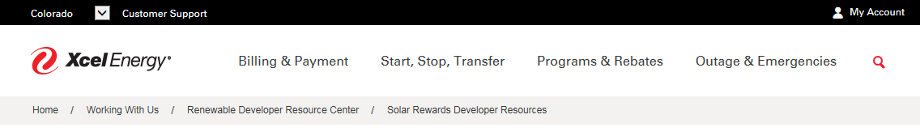
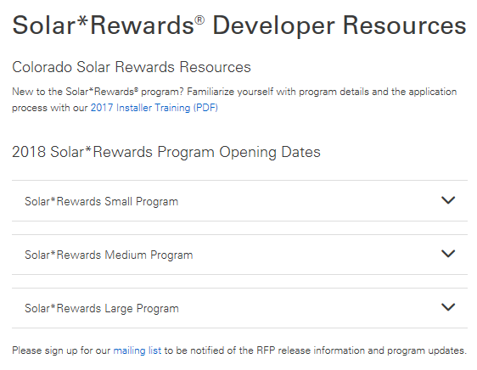
Solar*Rewards Dashboard on XcelEnergy.com
Combined Stakeholder Group
Link: https://www.xcelenergy.com/working_with_us/renewable_developer_resource_center/solar_rewards_developer_resources
Notes:
Solar*Rewards participation dropped in 2017. But, customer participation continues. Each offering leads to average system size of about 6 kW (roughly 8,500 kWh/year). Count and capacity are relatively interchangeable.
Net Metering averages 5.7 kW
Solar*Rewards average 6.1 kW
PV Watts- 6 kW at 10%, 180% south = 8,630 - http://pvwatts.nrel.gov/pvwatts.php

Slide 7
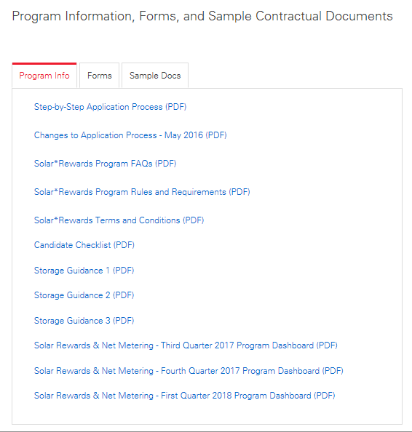
Solar*Rewards Dashboard on XcelEnergy.com
Combined Stakeholder Group
Link: https://www.xcelenergy.com/working_with_us/renewable_developer_resource_center/solar_rewards_developer_resources

Slide 8
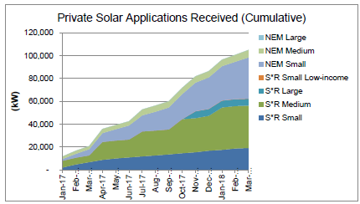
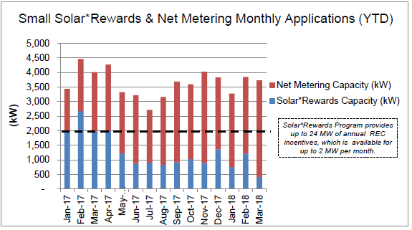
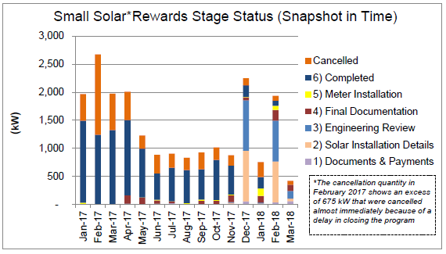
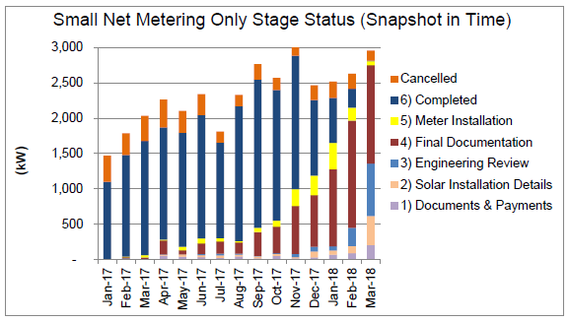
Solar*Rewards Dashboard for Q1 2018 - Small
Combined Stakeholder Group

Slide 9
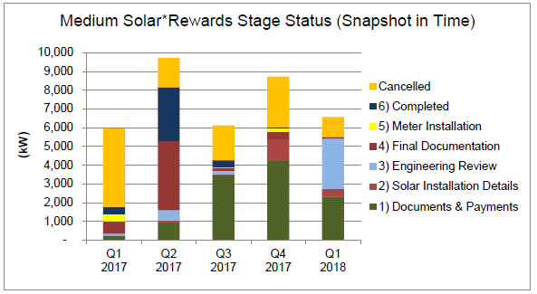
Solar*Rewards Dashboard for Q1 2018 - Medium
Combined Stakeholder Group
Next Medium Program Opening – July 9th @ 10AM MT
REC Price $0.0425/kWh
6.175 MW available (175kW rollover capacity from no deposit received)
Notes:
Open for almost 1 month, exactly

Slide 10
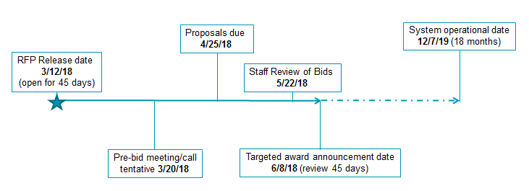
Solar*Rewards Dashboard for Q1 2018 – Large
Combined Stakeholder Group
2018 Large Solar*Rewards Program Scope
Competitive bid for up to 10 MW of solar sited and interconnected at customer
System size of ≥500kW, up to120% of annual use
Bid for Renewable Energy Credit (REC) incentive ($/MWh) for 20 year- term
2018 Competitive Bid Results
Total Bids Received: 4 for 12.362 MW
Bids and Capacity Awarded: 3 projects for 9.362 MW
Capacity Available in 2019 Program: 14.638 MW
10
Notes:
Open for almost 1 month, exactly

Slide 11
On-site Storage Update
Combined Stakeholder Group
Application Stage | Count
Solar Installation Details | 11
Documents and Payments | 22
Engineering Review | 25
Final Documentation | 137
Meter Installation | 7
Completed | 93
Grand Total | 295
46 applications for standalone/retrofit storage systems
249 application paired with new solar
10 pre-reviews approved for different storage packages
11

Slide 12
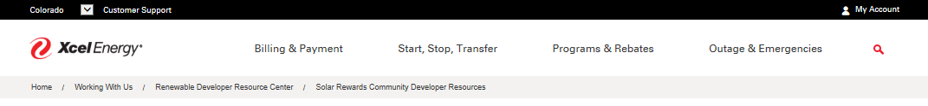

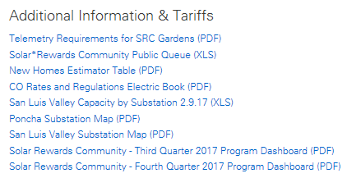
Solar*Rewards Community Dashboard on XcelEnergy.com
Combined Stakeholder Group
Link: https://www.xcelenergy.com/working_with_us/renewable_developer_resource_center/solar_rewards_community_developer_resources
12

Slide 13
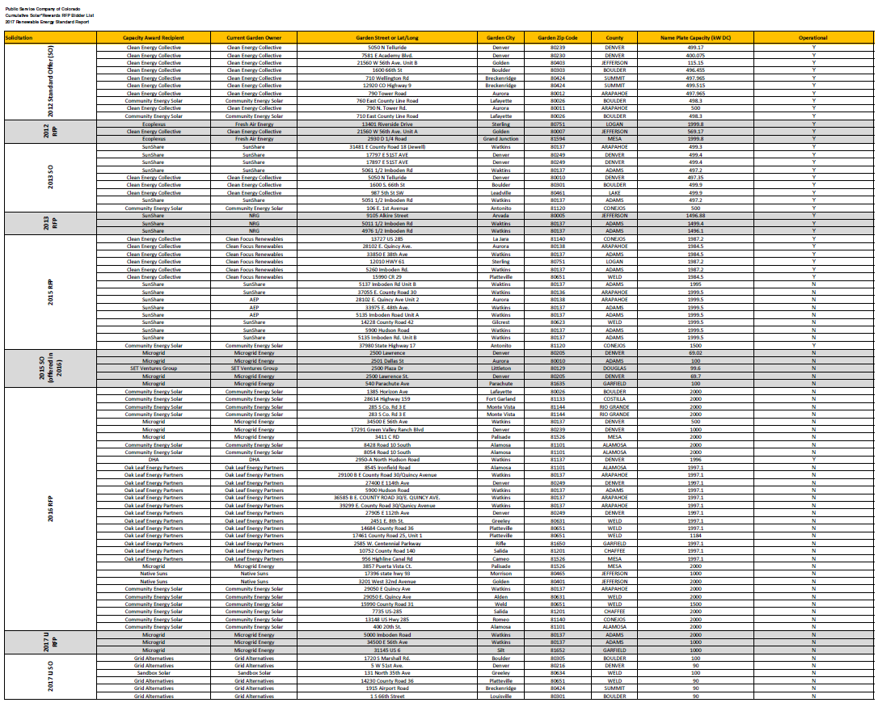
Solar*Rewards Community Dashboard on XcelEnergy.com
Combined Stakeholder Group
Link: https://www.xcelenergy.com/working_with_us/renewable_developer_resource_center/solar_rewards_community_developer_resources
13

Slide 14
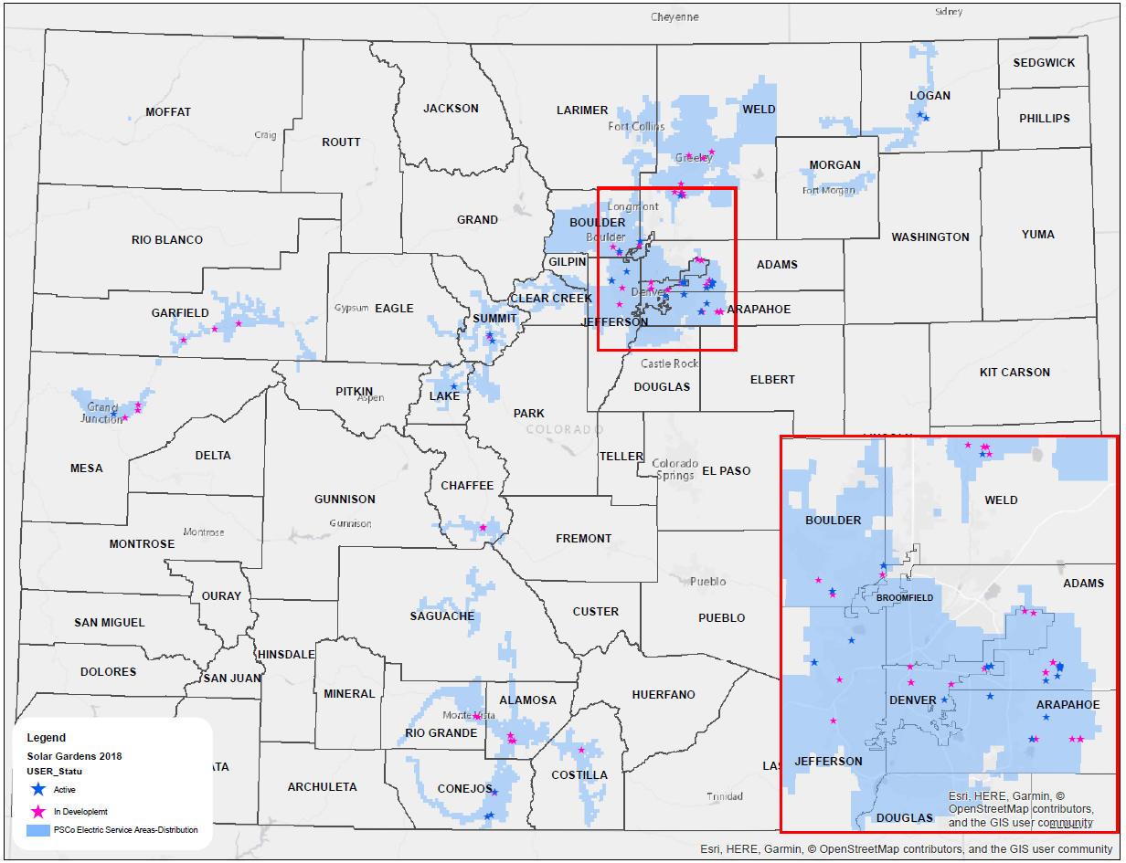
Solar*Rewards Community
Combined Stakeholder Group
14

Slide 15
Solar*Rewards Community: Garden Status
Combined Stakeholder Group
Current Solar Rewards Project Status by Capacity
Total Project Capacity: 111.6 MW
39.5 MW active solar gardens
72.1 MW in development
MW
Vintage
15
Notes:
112.5 open

Slide 16
Solar*Rewards Community: Project Updates
Combined Stakeholder Group
2012-2016 Vintage S*RC Projects:
6MW interconnected in Q1 for a total of 39.5 MW
Every 2016 Award will have an IA by Q3. ~60 MW from that RFP
2016 SR*C Standard Offer
1MW of capacity still open for projects up to 100 MW each
REC price set from the 2017 RFP $0.0282/kWh
2017 Low Income S*RC Competitive Bid
4MW of 100% Low Income gardens will likely interconnect in 2018
2017 S*RC Competitive Bid
Between 15 and 27 MW of capacity
On track to be awarded around July 16
16

Slide 17
Proposed RFP Scoring Changes
Combined Stakeholder Group
Two Options:
  Option 1: Ratio Scoring allows for additional commitments
  Option 2: Point Based scoring/weighting outline in RFP
For Both Options: Update RFP with transparent scoring for bidders
Neither Options: Require subscriber mix as we do not have sufficient data to show if any subscriber type is being underserved by the program
17

Slide 18
Option #1 – Ratio Scoring
Combined Stakeholder Group
We are calling this the Effectiveness Ratio in which head REC price is divided by the Bill Reduction Percentage (BRP) commitment. The idea is that a bid of $1/REC MW with a commitment to 100% BRP would have a perfect score of 1, the lower the score the more effective the project is at the goal of being low cost to rate payers while meeting the goal of the RFP to assist low income customers.
Example
If a bid proposes to have 30% bill reduction and has a REC price of $20/MWh they would have a score of 66.66 ($20/0.3).
The best ratio score gets the most points with each subsequent score receiving less points proportional on how many bids were received.
Economic Criteria | 65
Ratio Score | 65
Non-Economic | 35
Developer Experience | 15
Energy & REC Production | 10
Additional LI Considerations (Job training, EE, etc.) | 10
Other (tie breakers)
Geographic
Construction Milestones
*Developers/Industry must submit reporting and penalty suggestions for this change*
18

Slide 19
Example Bid Scoring for Option #1
Combined Stakeholder Group
Garden Name | kW | $/MWh | Claim of saving to customers | Ratio | Ratio Score | Developer Experience | Energy Production | Additional Commitment | Bid Score
CSG Bid 2 | 1000 | $20.00 | 0.3 | 66.67 | 58.5 | 6 | 2 | 13.5 | 80
CSG Bid 1 | 1000 | $15.00 | 0.3 | 50.00 | 65 | 5 | 1 | 6 | 77
CSG Bid 3 | 2000 | $25.00 | 0.3 | 83.33 | 52 | 9 | 3 | 12 | 76
CSG Bid 5 | 2000 | $35.00 | 0.4 | 87.50 | 39 | 10 | 4 | 10.5 | 63.5
CSG Bid 4 | 2000 | $30.00 | 0.35 | 85.71 | 45.5 | 8 | 6 | 3 | 62.5
CSG Bid 6 | 500 | $40.00 | 0.45 | 88.89 | 32.5 | 4 | 7 | 4.5 | 48
CSG Bid 7 | 500 | $45.00 | 0.5 | 90.00 | 26 | 1 | 8 | 7.5 | 42.5
CSG Bid 8 | 1000 | $50.00 | 0.5 | 100.00 | 13 | 7 | 5 | 15 | 40
CSG Bid 9 | 1500 | $60.00 | 0.65 | 92.31 | 19.5 | 2 | 9 | 9 | 39.5
CSG Bid 10 | 1500 | $70.00 | 0.65 | 107.69 | 6.5 | 3 | 10 | 1.5 | 21
19

Slide 20
Option #2 – Point Based Weighting
Combined Stakeholder Group
This is a straight point based system that give the max points to the best of each category, with subsequent points being subtracted based on the number of bids received.
Economic Criteria | 50
REC Price | 50
Non-Economic | 50
Developer Experience | 15
Energy & REC Production | 15
Additional LI Commitment (Job training, EE, etc.) | 20
Other (tie breakers)
Geographic
Construction Milestones
Bill Credit Reduction
20

Slide 21
Example Bid Scoring for Option #2
Combined Stakeholder Group
Garden Name | kW | $/MWh | Claim of saving to customers | REC Price Score | Developer Experience | Energy Production | Additional Commitment | Bid Score
CSG Bid 1 | 1000 | $15.00 | 0.3 | 50 | 10.5 | 9 | 2 | 71.5
CSG Bid 2 | 1000 | $20.00 | 0.3 | 45 | 7.5 | 7.5 | 4 | 64
CSG Bid 4 | 2000 | $30.00 | 0.35 | 35 | 4.5 | 15 | 8 | 62.5
CSG Bid 3 | 2000 | $25.00 | 0.3 | 40 | 6 | 6 | 6 | 58
CSG Bid 5 | 2000 | $35.00 | 0.4 | 30 | 15 | 3 | 10 | 58
CSG Bid 7 | 500 | $45.00 | 0.5 | 20 | 12 | 10.5 | 14 | 56.5
CSG Bid 6 | 500 | $40.00 | 0.45 | 25 | 13.5 | 1.5 | 12 | 52
CSG Bid 8 | 1000 | $50.00 | 0.5 | 15 | 9 | 12 | 16 | 52
CSG Bid 9 | 1500 | $60.00 | 0.65 | 10 | 1.5 | 13.5 | 18 | 43
CSG Bid 10 | 1500 | $70.00 | 0.65 | 5 | 3 | 4.5 | 20 | 32.5
21

Slide 22

Windsource Overview
Combined Stakeholder Group
Program Stats
1.5 cents/kWh (or $1.50/block)
RECs retired on behalf of customer
2017 Annual Sales 187,620 MWh
2017 RESA contributions $2.89M
~42,000 participants
  ~41,000 residential
  ~700 business
Marketing/Admin recovered in base rates
Regulatory History
2009 redesign, sales credited to RESA to fund renewable acquisition
2016 3 case settlement allowed for market based pricing reduction to $1.50/block
Notes:
Previous to 2016, methodology was cost-based approach and set the premium at the average of the first 5 years of incremental costs of the addition of the wind to system. Due to PTC and lowered pricing, the thought was the cost based method would result in a very low or possibly negative premium prices.

Slide 23
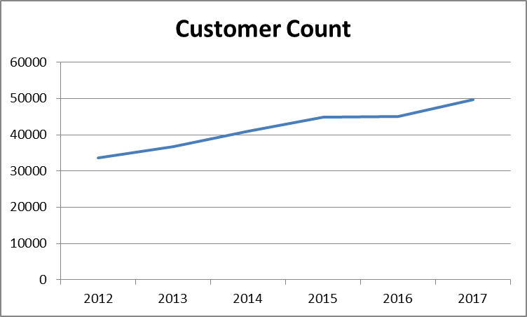
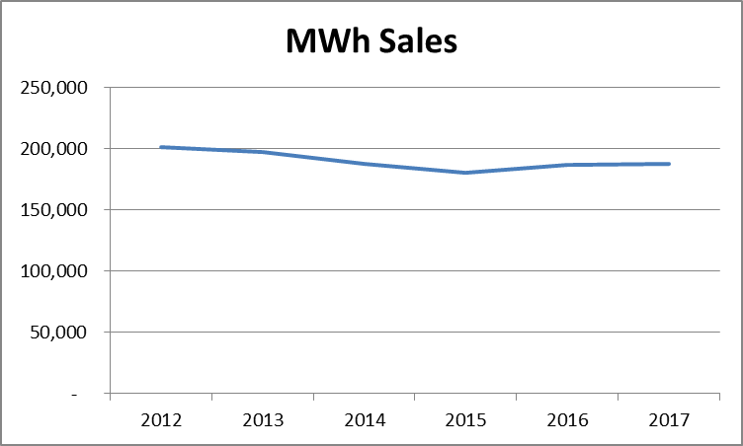
Windsource Trends
Combined Stakeholder Group
Increasing customer counts
Flat/decreasing sales

Slide 24
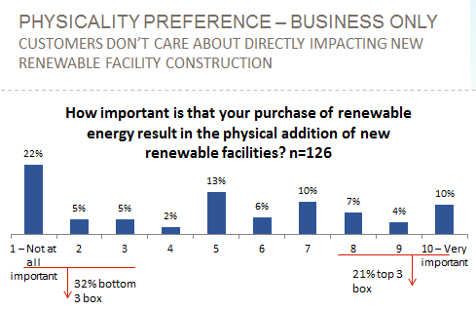
Customers don’t care about location
Combined Stakeholder Group
Source: 2015 Colorado Panel Survey

Slide 25
Only ~20% of customers are willing to pay a premium
Combined Stakeholder Group
Please indicate the maximum you'd be willing to pay for a renewable energy product
Source: 2015 Colorado Renewable Survey with 897 residents and 1,018 businesses

Slide 26
Transition Considerations
Combined Stakeholder Group
Customer
~42,000 participants
~41,000 residential
~700 business
Plan for Windsource survey this summer
Resource
New Wind
Old Wind
New Solar
Blended wind + solar
Economics
Wind prices are lower than solar but the Capacity Credit will also be much lower
Notes:
187,620 MWh of Sales =
86 MW Old Wind
54 MW New Wind
71 MW New Solar
18 MW New Solar / 40 MW New Wind (25/75 blend)
Scale assumes:
Old wind CF of 25%
New wind CF of 40%
New solar CF of 30%

Slide 27

Early Coal Plant Retirement Survey Questions
Combined Stakeholder Group
Refer to handout
Based on previously shared survey questions
Included in Renewable*Connect post enrollment survey
Currently in field

Slide 28
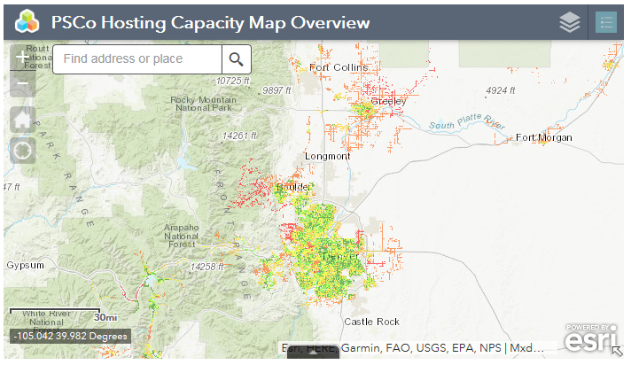
Hosting Capacity Map
Combined Stakeholder Group
Hosting Capacity Map
How To Interconnect Page

Slide 29
2018 Legislative Session
Combined Stakeholder Group
SB18-009 (Sen. Fenberg Battery Bill):
  Requires Rulemaking – Miscellaneous Proceeding (a.k.a. M-Docket)?
  Principles:
(d) UTILITIES SHALL NOT REQUIRE THE INSTALLATION OF CUSTOMER-SITED METERS IN ADDITION TO A SINGLE NET ENERGY METER FOR THE PURPOSES OF MONITORING ENERGY STORAGE SYSTEMS; EXCEPT THAT THE COMMISSION MAY AUTHORIZE THE REQUIREMENT OF METERING FOR CERTAIN LARGE ENERGY STORAGE SYSTEMS, AS DETERMINED BY THE COMMISSION.
HB18-1270 (Rep. Hansen Energy Storage Bill):
  Requires Rulemaking – M-Docket?
  ON OR BEFORE FEBRUARY 1, 2019, THE COMMISSION SHALL ESTABLISH, BY RULE, AS PART OF THE PLANNING PROCESS, MECHANISMS FOR THE PROCUREMENT OF ENERGY STORAGE SYSTEMS BY AN ELECTRIC UTILITY; EXCEPT THAT THESE MECHANISMS MUST NOT AFFECT ANY ONGOING RESOURCE ACQUISITIONS OR COMPETITIVE BIDDING PROCESSES THAT EXISTED ON FEBRUARY 1, 2018.

Slide 30
2018 Legislative Session (Cont…)
Combined Stakeholder Group
HB18-1271 (Eco-Devo Bill):
    Requires Commission Approval – Application.
  AN INVESTOR-OWNED ELECTRIC UTILITY SUBJECT TO RATE REGULATION BY THE COMMISSION MAY OFFER ECONOMIC DEVELOPMENT RATES TO A QUALIFYING COMMERCIAL OR INDUSTRIAL CUSTOMER.
    FOR UP TO TEN YEARS.
  INVESTOR-OWNED UTILITY MAY SEEK COMMISSION APPROVAL TO EXPAND ANY VOLUNTARY RENEWABLE ENERGY PROGRAM OR SERVICE OFFERING…

Slide 31
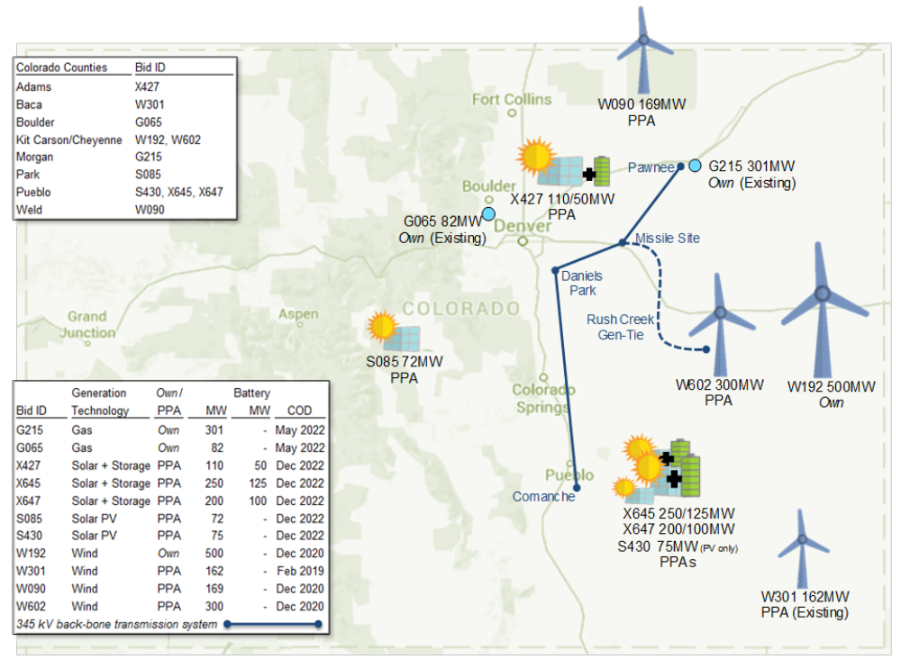
120-Day Report:
Preferred Colorado Energy Plan Portfolio
Combined Stakeholder Group
Colorado Energy Plan
Customer
Economics
Environment
Up to 1,100 MW capacity need driven by early retirement of Comanche 1 & 2
Expected total cost is $215M in customer savings
~60% reduction from 2005 CO²
~90% reduction from 2005 NOx and SO²
~$2.5B total investment
27% renewable utility ownership
~55% Renewables by 2026
Fuel hedge benefit
Across eight counties in Colorado

Slide 32
Stakeholder Groups vs Workshops
Combined Stakeholder Group
Overlapping topics – What venue?
  Examples:
    Grid Stakeholder Group – Interconnection Rules Evaluation
    Future Programs – Voluntary contributions toward early retirement of existing fossil fuel generation
    Existing Programs – Low Income Participation
Are there topics to remove from discussion?
  Legislative changes necessary to enable further cost effective achievement of the goals of § 40-2-124, C.R.S.
  Others?

Slide 33
RES Report/Settlement Progress Update
Combined Stakeholder Group
2017 RES Report filed June 1:
  xcelenergy.com / Home / Company / Rates & Regulations / Filings / Renewable Energy Plans & Reports
  New Attachments:
    Attachment J – CEO Report – Solar for Low Income and the Weatherization Assistance Program
    Attachment K – Stakeholder Group Progress
Stakeholder Group: | Q4 2016 | Q1 2017 | Q2 2017 | Q3 2017 | Q4 2017
Grid | 11/03, 11/10, 12/02, 12/21 | 1/18, 3/17 | 6/27
Future Programs |  | 3/3 | 5/31, 9/8
Existing Programs |  | 2/3 | 4/7, 6/27
CombinedP5F |  |  |  | 09/22 | 12/15

Slide 34
Wrap Up
Combined Stakeholder Group
Review Action Items
Future Agenda Items
Next Meeting Scheduled for August 24th
34

Slide 35


